Slide 1
Introducing Classes
A class is declared by use of the class keyword
class classname {
type instance-variable1;
type instance-variable2;
// ...
type instance-variableN;
type methodname1(parameter-list) {
// body of method
}
type methodname2(parameter-list) {
// body of method
}
// ...
type methodnameN(parameter-list) {
// body of method
}
}

Slide 2
Class
The data, or variables, defined within a class are called instance variables.
The code is contained within methods.
Collectively, the methods and variables defined within a class are called members of the class.
Variables defined within a class are called instance variables because each instance of the class (that is, each object of the class) contains its own copy of these variables.
Thus, the data for one object is separate and unique from the data for another.

Slide 3
A Simple Class
class Box {
double width;
double height;
double depth;
}
To actually create a Box object,
Box mybox = new Box(); // create a Box object called mybox

Slide 4
Class
Every Box object will contain its own copies of the instance variables width, height, and depth.
To access these variables, you will use the dot (.) operator.
The dot operator links the name ofthe object with the name of an instance variable
mybox.width = 100;
In general, use the dot operator to access both the
instance variables and the methods within an object.

Slide 5
Demo 1
class Box {
double width;
double height;
double depth;
}
class BoxDemo {
public static void main(String args[]) {
Box mybox = new Box();
double vol;
mybox.width = 10;
mybox.height = 20;
mybox.depth = 15;
vol = mybox.width * mybox.height * mybox.depth;
System.out.println("Volume is " + vol);
}
}

Slide 6
Demo 2
class BoxDemo2 {
public static void main(String args[]) {
Box mybox1 = new Box();
Box mybox2 = new Box();
double vol;
mybox1.width = 10;
mybox1.height = 20;
mybox1.depth = 15;
mybox2.width = 3;
mybox2.height = 6;
mybox2.depth = 9;
vol = mybox1.width * mybox1.height * mybox1.depth;
System.out.println("Volume is " + vol);
vol = mybox2.width * mybox2.height * mybox2.depth;
System.out.println("Volume is " + vol);
}
}

Slide 7
Declaring Objects
When you create a class, you are creating a new data type. You can use this type to declare objects of that type.
Obtaining objects of a class is a two-step process.
1. you must declare a variable of the class type.
2. you must acquire an actual, physical copy of the object and assign it to that variable
The new operator dynamically allocates (that is, allocates at run time) memory for an object and returns a reference to it.

Slide 8
Declaring Objects
Box mybox = new Box();
This statement combines the two steps. It can be rewritten like this to show each step more clearly:
Box mybox; // declare reference to object
mybox = new Box(); // allocate a Box object
you cannot cause an object reference to point to an arbitrary memory location or manipulate it like an integer.

Slide 9
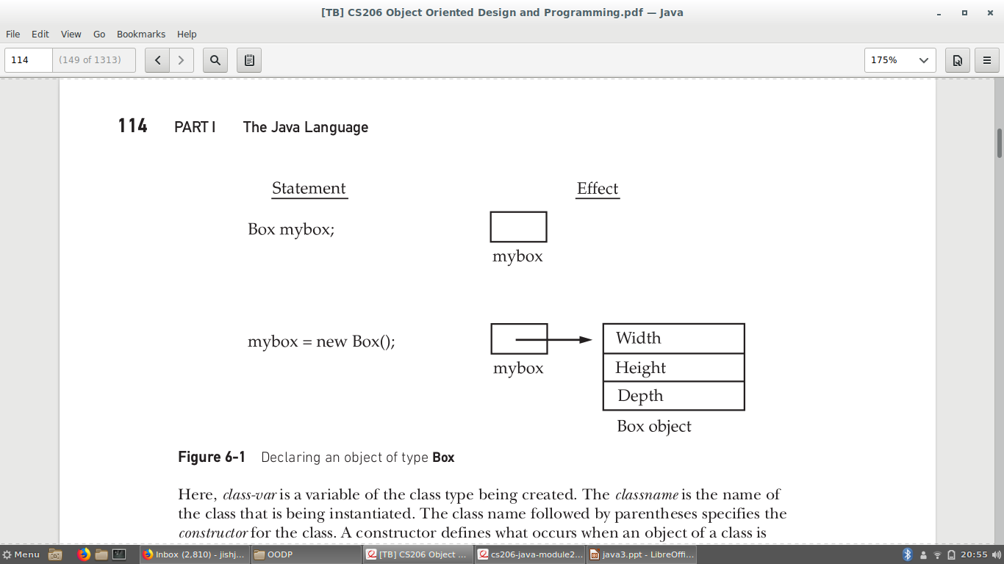
A Closer Look at new

Slide 10
A Closer Look at new
class-var = new classname ( );
class-var is a variable of the class type being created.
The classname is the name of the class that is being instantiated.
The class name followed by parentheses specifies the constructor for the class.
A constructor defines what occurs when an object of a class is created.

Slide 11
A Closer Look at new
new allocates memory for an object during run time.
The advantage of this approach is that your program can create as many or as few objects as it needs during the execution of your program.
Since memory is finite, it is possible that new will not be able to allocate memory for an object because insufficient memory exists. If this happens, a run-time exception will occur.

Slide 12
Assigning Object Reference Variables
Box b1 = new Box();
Box b2 = b1;
b1 and b2 will both refer to the same object.
The assignment of b1 to b2 did not allocate any memory or copy any part of the original object.
It simply makes b2 refer to the same object as does b1.

Slide 13
Assigning Object Reference
Box b1 = new Box();
Box b2 = b1;
// ...
b1 = null;
Here, b1 has been set to null, but b2 still points to the original object.
When you assign one object reference variable to another object reference variable, you are not creating a copy of the object, you are only making a copy of the reference.

Slide 14
Introducing Methods
General form of a method:
type name(parameter-list) {
// body of method
}
Type-any valid type including class type
If the method does not return a value, its return type must be void

Slide 15
Adding a Method to the Box Class
class Box {
double width;
double height;
double depth;
// display volume of a box
void volume() {
System.out.print("Volume is ");
System.out.println(width * height * depth);
}
}

Slide 16
class BoxDemo3 {
public static void main(String args[]) {
Box mybox1 = new Box();
Box mybox2 = new Box();
mybox1.width = 10;
mybox1.height = 20;
mybox1.depth = 15;
mybox2.width = 3;
mybox2.height = 6;
mybox2.depth = 9;
mybox1.volume();
mybox2.volume();
}
}

Slide 17
Method
The instance variables width, height, and depth are referred to directly, without preceding them with an object name or the dot operator.
When a method uses an instance variable that is defined by its class, it does so directly, without explicit reference to an object and without use of the dot operator.
A method is always invoked relative to some object of its class. Once this invocation has occurred, the object is known.

Slide 18
When an instance variable is accessed by code that is not part of the class in which that instance variable is defined, it must be done through an object, by use of the dot operator.
However, when an instance variable is accessed by code that is part of the same class as the instance variable, that variable can be referred to directly.
The same thing applies to methods.

Slide 19
Returning a Value
The type of data returned by a method must be compatible with the return type specified by the method.
For example, if the return type of some method is boolean, you could not return an integer.
The variable receiving the value returned by a method must also be compatible with the return type specified for the method.

Slide 20
In Box
double volume() {
return width * height * depth;
}
In BoxDemo main
Double vol;
Box mybox1 = new Box();
vol = mybox1.volume();
System.out.println("Volume is " + vol);

Slide 21
Adding a Method That Takes Parameters
int square(int i)
{
return i * i;
}

Slide 22
class Box {
double width;
double height;
double depth;
double volume() {
return width * height * depth;
}
void setDim(double w, double h, double d) {
width = w;
height = h;
depth = d;
}
}

Slide 23
class BoxDemo5 {
public static void main(String args[]) {
Box mybox1 = new Box();
Box mybox2 = new Box();
double vol;
mybox1.setDim(10, 20, 15);
mybox2.setDim(3, 6, 9);
vol = mybox1.volume();
System.out.println("Volume is " + vol);
vol = mybox2.volume();
System.out.println("Volume is " + vol);
}
}

Slide 24
Constructors
A constructor initializes an object immediately upon creation.
It has the same name as the class in which it resides and is syntactically similar to a method.
Once defined, the constructor is automatically called when the object is created, before the new operator completes.
It has no return type, not even void. This is because the implicit return type of a class’ constructor is the class type itself.

Slide 25
class Box {
double width;
double height;
double depth;
// This is the constructor for Box.
Box() {
System.out.println("Constructing Box");
width = 10;
height = 10;
depth = 10;
}
// compute and return volume
double volume() {
return width * height * depth;
}
}

Slide 26
class BoxDemo6 {
public static void main(String args[]) {
// declare, allocate, and initialize Box objects
Box mybox1 = new Box();
Box mybox2 = new Box();
double vol;
// get volume of first box
vol = mybox1.volume();
System.out.println("Volume is " + vol);
// get volume of second box
vol = mybox2.volume();
System.out.println("Volume is " + vol);
}
}

Slide 27
When this program is run, it generates the following results:
Constructing Box
Constructing Box
Volume is 1000.0
Volume is 1000.0
Box mybox1 = new Box();
new Box( ) is calling the Box( ) constructor.
When you do not explicitly define a constructor for a class, then Java creates a default constructor for the class.
The default constructor automatically initializes all instance variables to their default values, which are zero, null, and false, for numeric types, reference types, and boolean, respectively.

Slide 28
Parameterized Constructors
class Box {
double width;
double height;
double depth;
Box(double w, double h, double d) {
width = w;
height = h;
depth = d;
}
double volume() {
return width * height * depth;
}
}

Slide 29
class BoxDemo7 {
public static void main(String args[]) {
// declare, allocate, and initialize Box objects
Box mybox1 = new Box(10, 20, 15);
Box mybox2 = new Box(3, 6, 9);
double vol;
// get volume of first box
vol = mybox1.volume();
System.out.println("Volume is " + vol);
// get volume of second box
vol = mybox2.volume();
System.out.println("Volume is " + vol);
}
}

Slide 30
The this Keyword
this can be used inside any method to refer to the current object.
// A redundant use of this.
Box(double w, double h, double d) {
this.width = w;
this.height = h;
this.depth = d;
}

Slide 31
Instance Variable Hiding
When a local variable has the same name as an instance variable, the local variable hides the instance variable.
// Use this to resolve name-space collisions.
Box(double width, double height, double depth) {
this.width = width;
this.height = height;
this.depth = depth;
}

Slide 32
Garbage Collection
Java handles deallocation automatically.This technique is called garbage collection.
when no references to an object exist, that object is assumed to be no longer needed, and the memory occupied by the object can be reclaimed.
Garbage collection only occurs periodically during the execution of your program.

Slide 33
The finalize( ) Method
Sometimes an object will need to perform some action when it is destroyed.
To handle such situations, Java provides a mechanism called finalization.
By using finalization, you can define specific actions that will occur when an object is just about to be reclaimed by the garbage collector.

Slide 34
The finalize() method
To add a finalizer to a class, you simply define the finalize( ) method.
The Java run time calls that method whenever it is about to recycle an object of that class.
Inside the finalize( ) method, you will specify those actions that must be performed before an object is destroyed.

Slide 35
The finalize( ) Method
General form:
protected void finalize( )
{
// finalization code here
}

